Slide 1

Hermes
Presentation
SPEAKER: Team B03 (Alita)
Jiang Zhou, Jiacheng Shen, Hanwen Zheng, Zichao Zhao

Slide 2

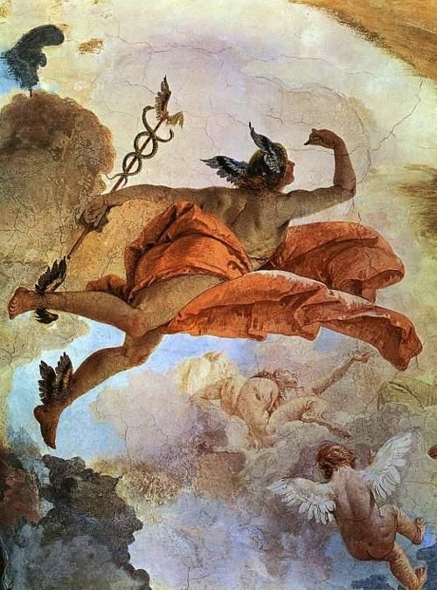
Demo
Hermes

Slide 3

CONTENTS
1.Functions
2.Introduction
3.Technology
4.Lessons

Slide 4

PART ONE
Functions

Slide 5
Demonstration
Three Main Functions
A. Register and Login
B. Upload, Download and Likes
C. Reward System

Slide 6
PART TWO
Introducton

Slide 7
Origin
PROJECT ORIGIN
PROJECT PROCESS
MOTIVATION

Slide 8

Alita
Jiang Zhou (Vincent) : Project Manager
Jiachen Shen (Carl) : Architect
Hanwen Zheng (Peter) : Front-end Engineer
Zichao Zhao : Tester

Slide 9

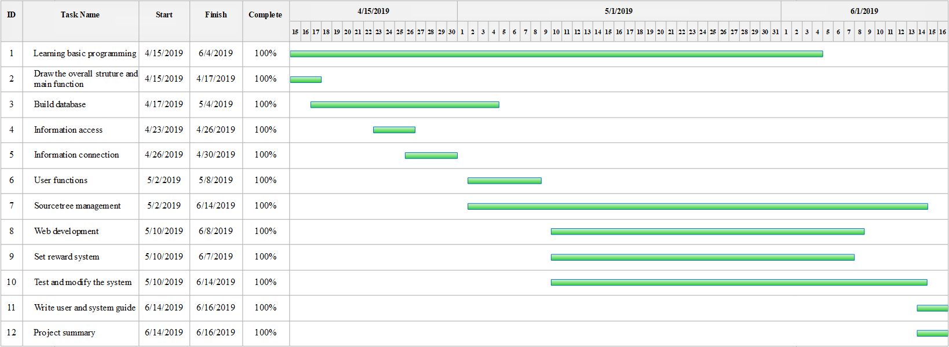
THREE PARTS
Scope
Login and register
Upload and download files
Points system

Slide 10
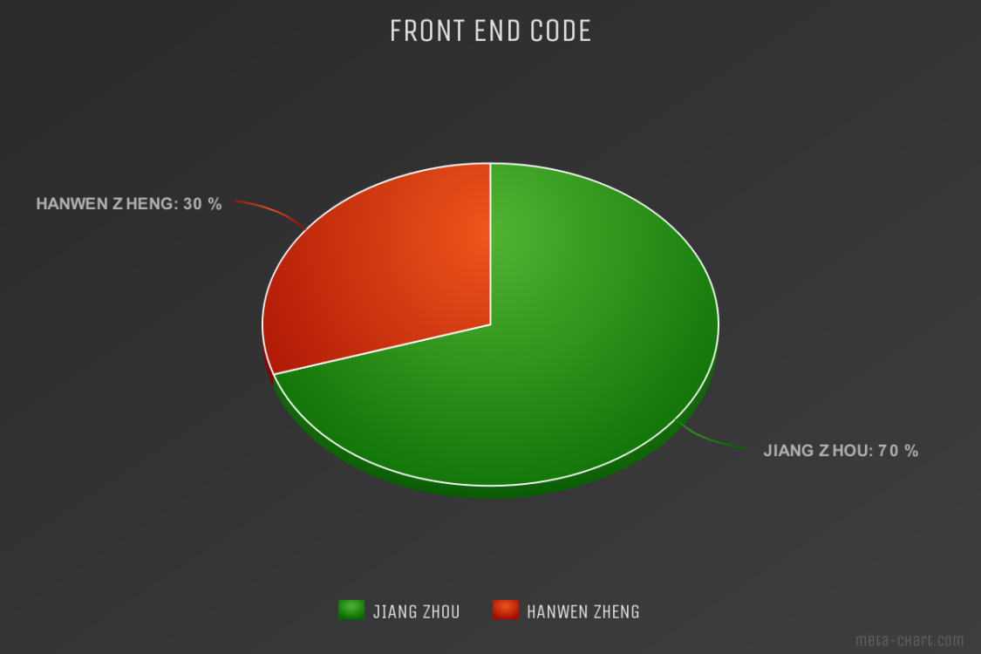
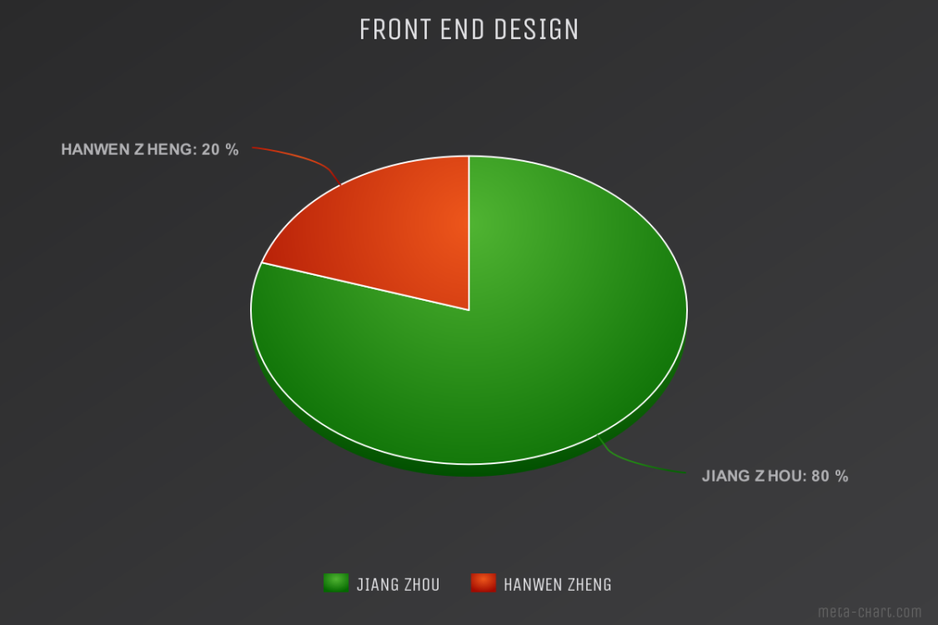
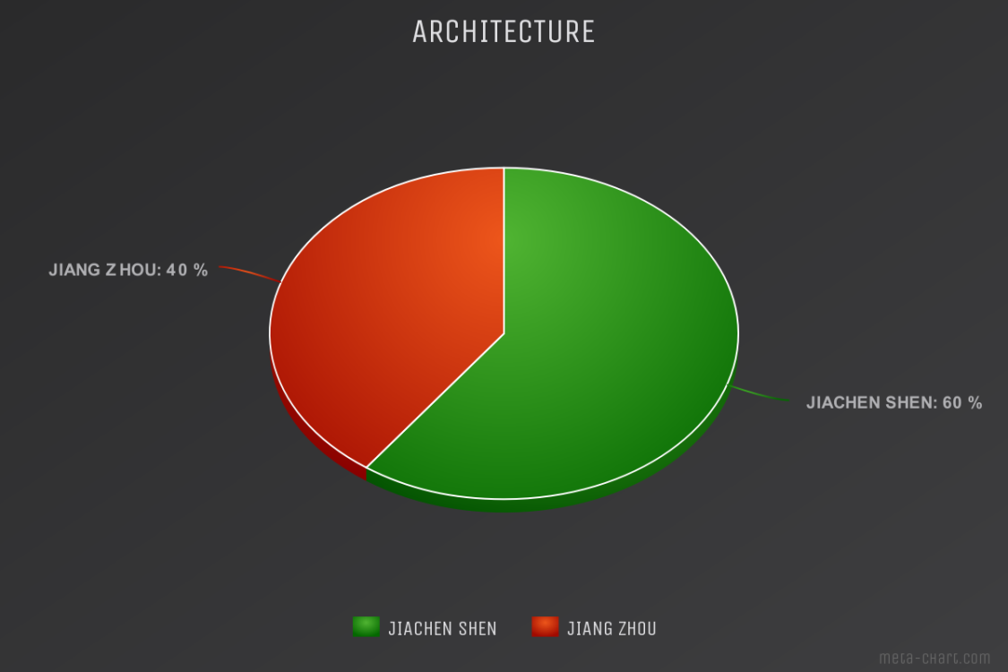
Division of labor
FRONT END CODE FRONT END DESIGN ARCHITETURE
Alita

Slide 11
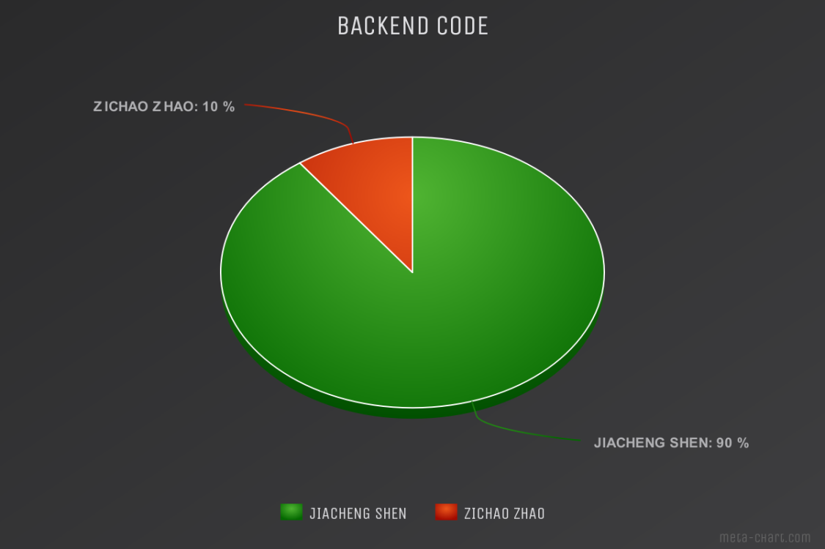
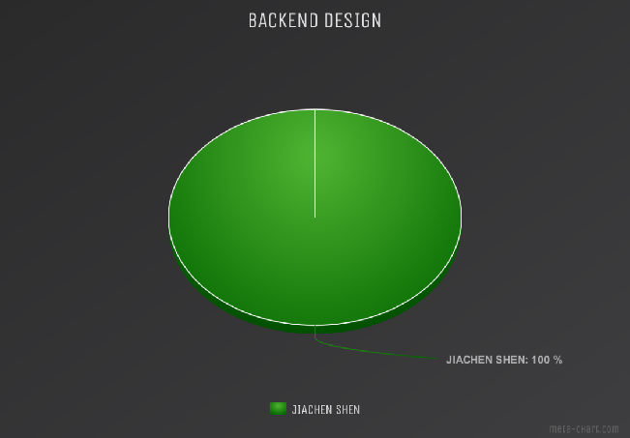
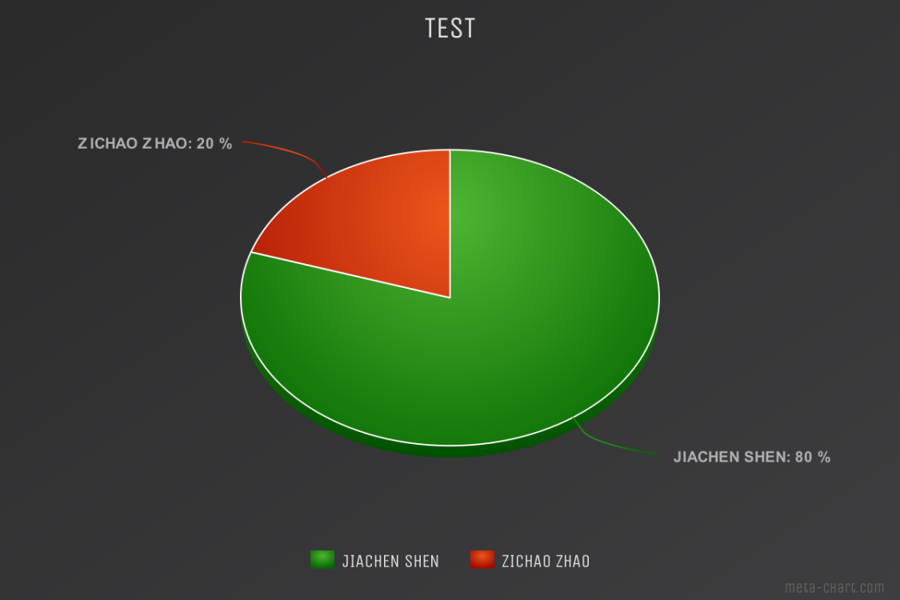
Division of labor
BACKEND CODE BACKEND DESIGN TEST
Alita

Slide 12

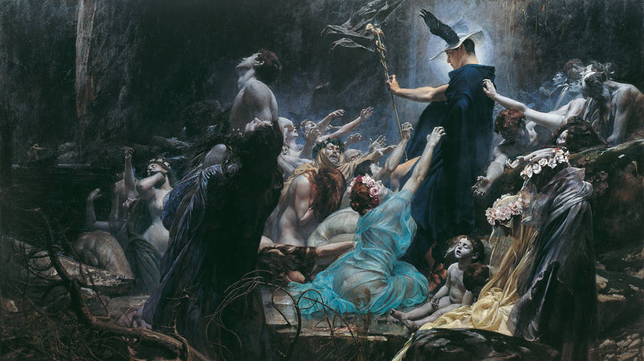
Selling point
Hermes
1. Good design
2. Quality resources
3. Points system

Slide 13
PART THREE
Technology

Slide 14
Overall architecture
Html(CSS,JS)+Python(Flask)+Sqlite3

Slide 15
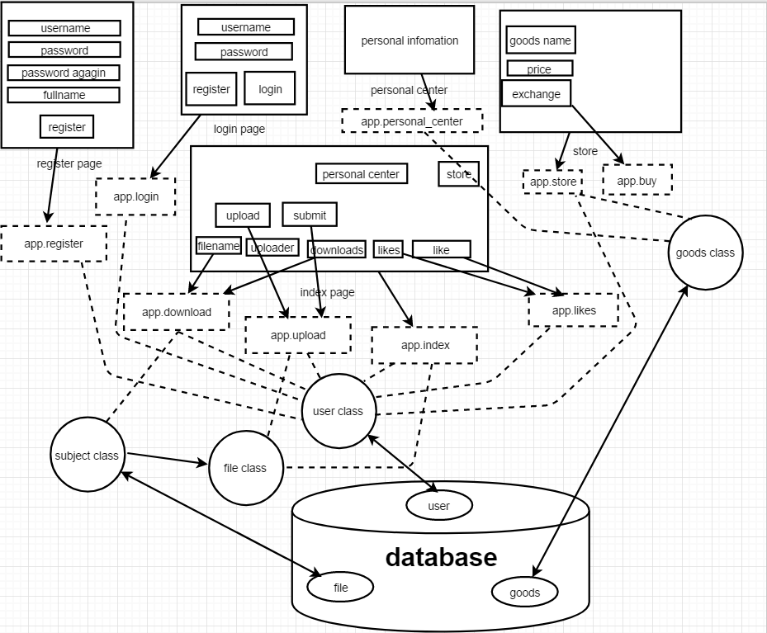

Slide 16
Three main system
1. Login and Register system
2. Files uploading and downloading system
3. Reward system

Slide 17
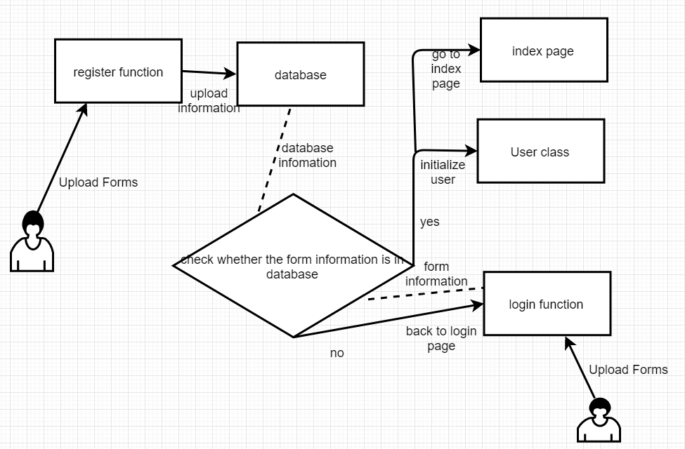
Login&register system

Slide 18
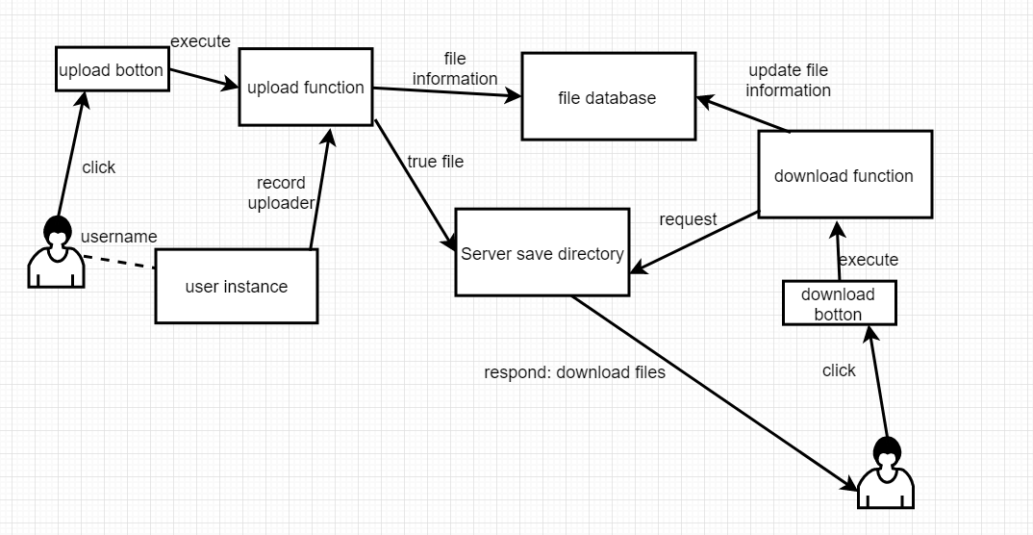
File downloading&uploading system

Slide 19
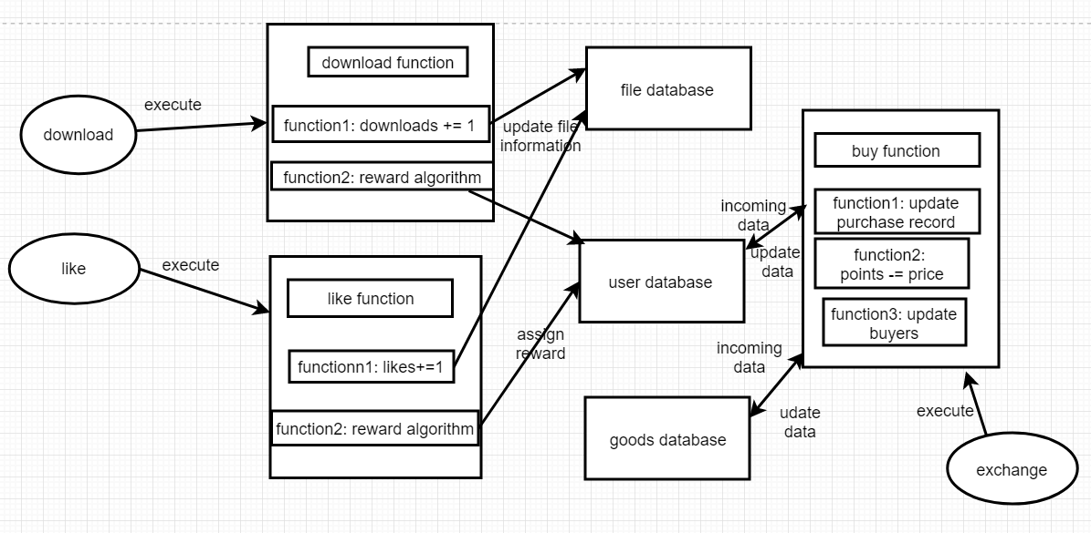
Reward system

Slide 20
PART FOUR
Lessons

Slide 21
Lessons
THE MOST VALUABLE THINGS
1.Back end first
2.Draw diagrams first
1.Design, plan
2.Team cooperation
1.Take consideration
2.Operation
1.Team management
2.Meetings

Slide 22
THANK YOU
SPEAKER: Team B03 (Alita)

